Slide 1
Mobile Automation
Oct 6, 2011

Slide 2
Agenda
Why Mobile Automation
Mobile Build Automation and Monitoring Strategy
Vincent Villanueva
Mobile Automation - Device Anywhere
Arun Sivaraman
Q&A

Slide 3
Mobile Build, Automation and Monitoring Strategy

Slide 4
What are the challenges for Build and Automation?
Different Devices…Different OSs
Apple, Google, Microsoft, RIM and others.
iOS, Android, Palm OS and others
Different languages and toolsets
No silver bullet

Slide 5
Build System…
Different ways to build… One interface…One Standard
Built around Hudson/Jenkins CI, self-service on-demand and continuous build system.
Different scripting and build tools (Ruby, Ant, Perl, Shell), but we need to standardize on the process
Build number format X.X.Yzzzbuild#
iPhone configurations (Debug, Release, Distribution, Distribution_QA, AppStore, AppStore_QA). Need something similar for Android/other builds.
X.X – Release (ex. 1.0)
Build number should be accessible from App (About->Version->Shake)
Y – Service Pack (ex. 1.0.1)
Zzz – Milestone (ex. 1.0.1a1)
Build# - internal builds (ex 1.0.1a1_build1)

Slide 6
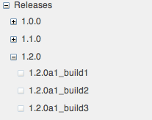
Build System…
Different ways to build… One interface…One Standard
Wiki Pages with standard content.
Releases (child page)
Version (X.X.Y)
Build pages

Slide 7
Build System…
RO(Read Only) checkin process – The process of checking in code then checking out locally in a different location and rebuilding and running tests (Unit and Functional UI automated tests).
Developers writing unit tests (Jon Reid jumpstarting in COMMON)
Developers designing testable code (e.g. accessibility labels, hooks, logs, mockups)
Different ways to build… One interface…One Standard
Continuous Integration (CI) builds running against every checkin (configurable grace period and polling SCM scheme)

Slide 8
Build System…
Different ways to build… One interface…One Standard
Multiple build systems
MobyBuilder/MobyServer/MobyWin/MobyGrid – on-demand, unit-level and MAT UI tests. Use this system for distributing builds (Distribution, Distribution_QA, AppStore, AppStore_QA)
MobyCI/MobyGrid – continuous integration build machine, runs every hour, running MAT tests.
OCUNIT
JUNIT
UI Automation
Integrated with DeviceAnywhere

Slide 9
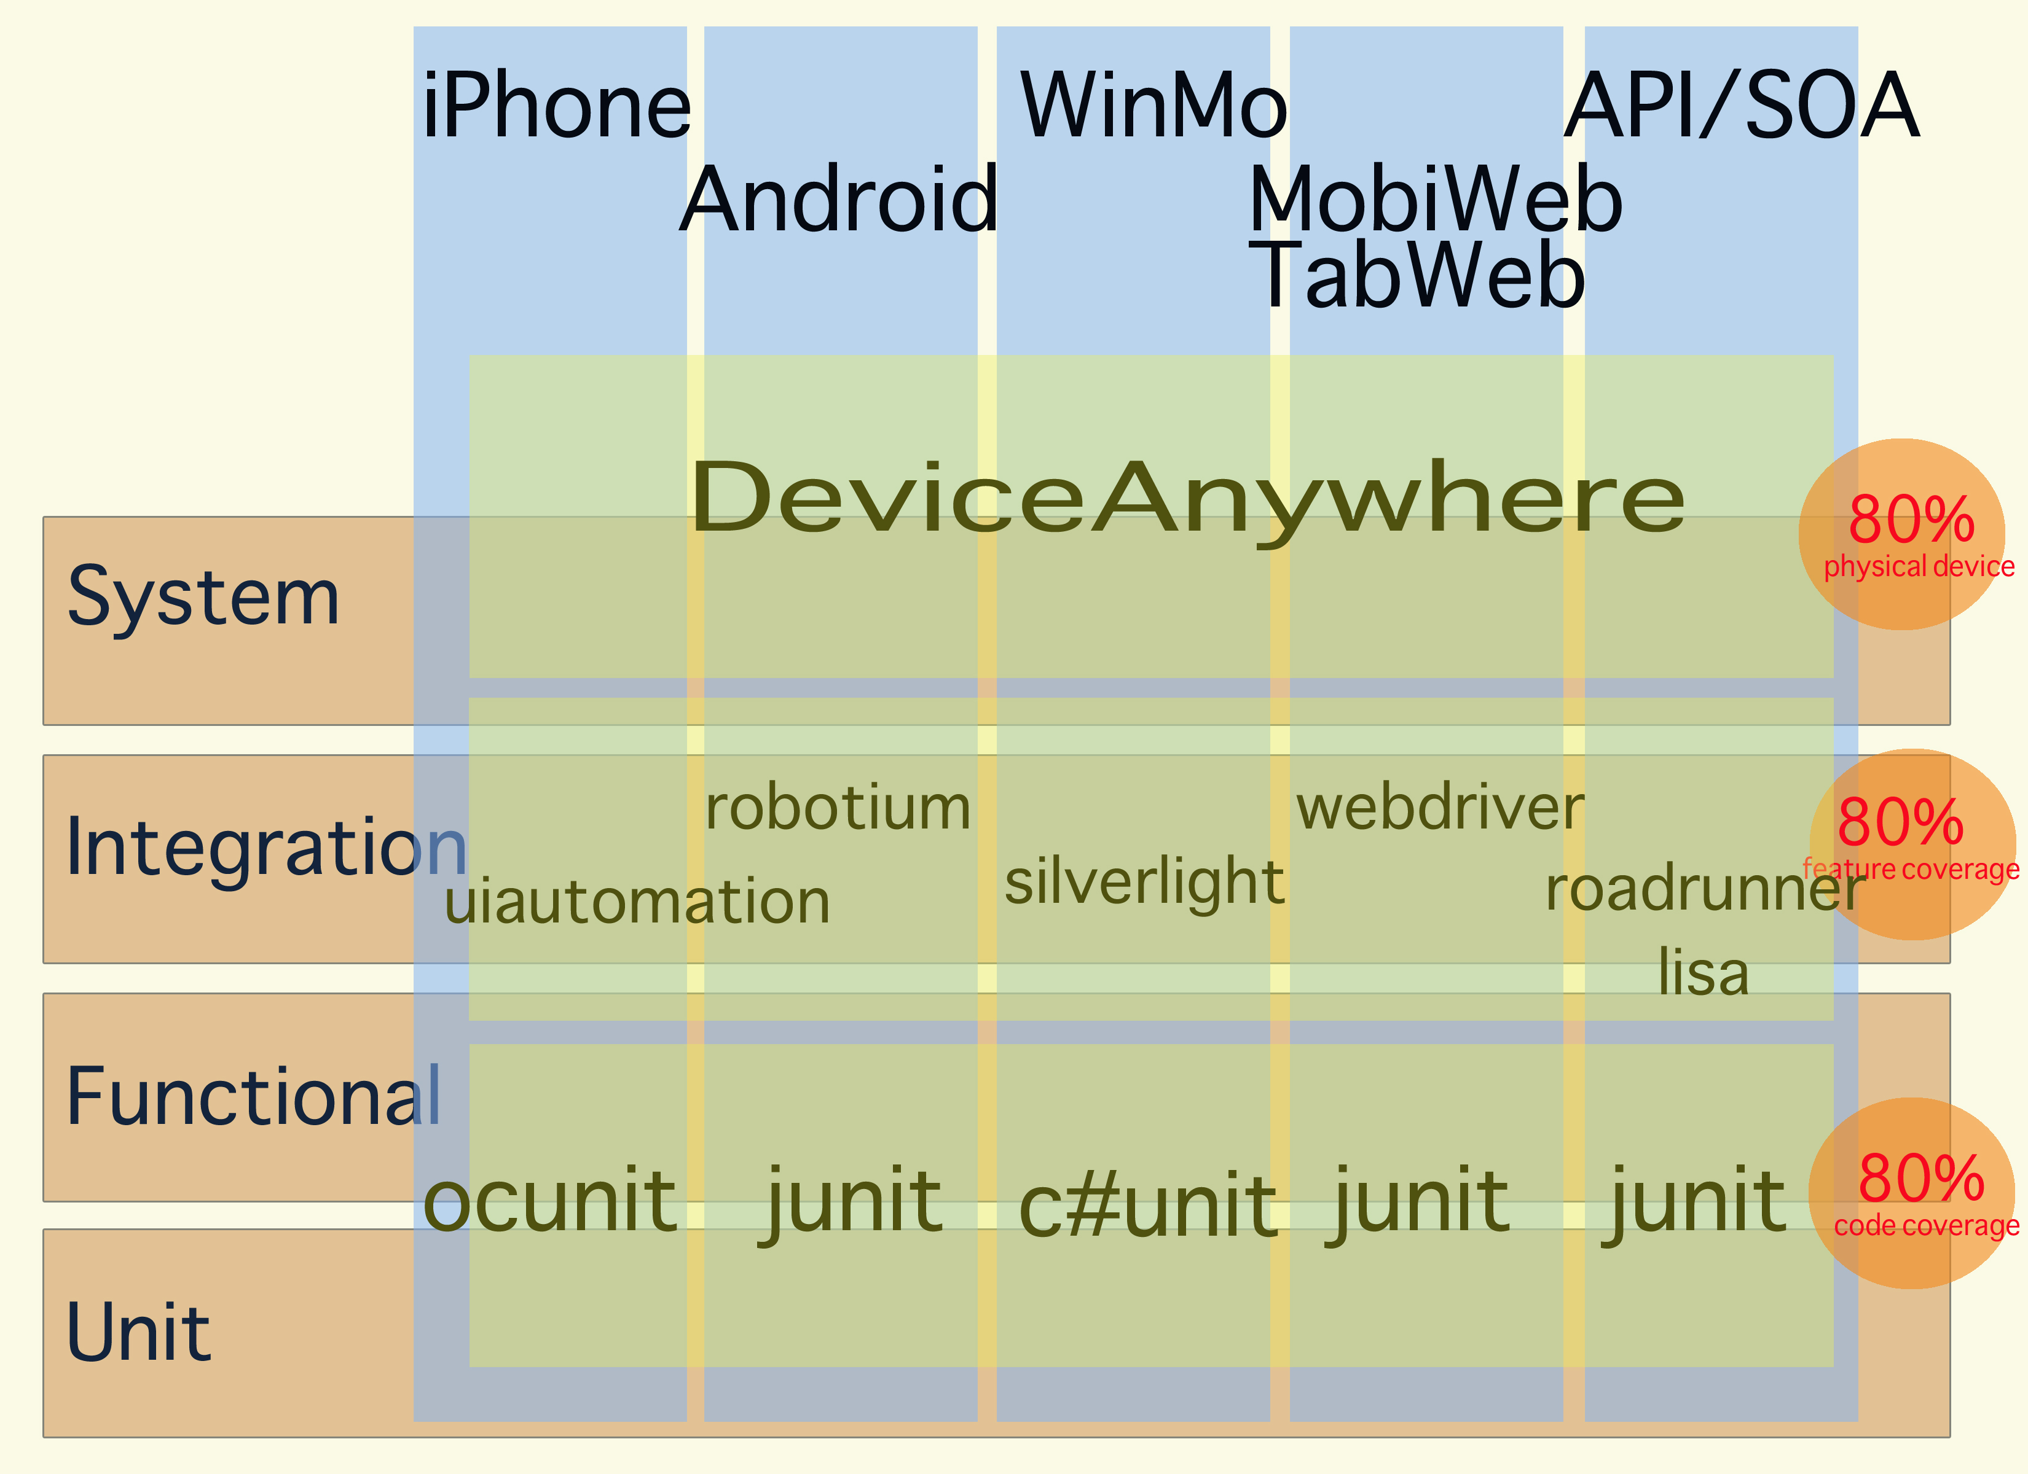
Different Levels…Different Solutions…One number 80

Slide 10
UI Automation Technologies
Leading UI Automation Technologies
UIAutomation (iPhone) – javascript, applescript
DeviceAnywhere – on device record/playback, image-finding, text-recognition
Robotium (Android) – java based automation, selenium-like
WebDriver (MobileWeb/TabWeb) – java based, firefox extension

Slide 11
DeviceAnywhere
Multiple Devices… Intuitive Test Development
Variety of Devices (ex. iPhone, Droid, Blackberry).
Visual test development
Network based
Single device ($12K - $15K / year)
Use cost ($6k / simultaneous users)
Image finding
Text recognition

Slide 12
Webdriver…Mobile/Tab Web Automation
A better Selenium
Instead of using javascript running within the browser, for Firefox it is implemented as an extension. For IE, it leverages IE’s automation controls.
// Create an instance of WebDriver backed by Firefox
WebDriver driver = new FirefoxDriver();
// Now go to the Google home page
driver.get("http://www.google.com");
// Find the search box, and (ummm...) search for something
WebElement searchBox = driver.findElement(By.name("q"));
searchBox.sendKeys("selenium");
searchBox.submit();
// And now display the title of the page
System.out.println("Title: " + driver.getTitle());

Slide 13
API RoadRunner/LISA API/Services Automation
API/Services Automation Goals
To Automate API and Services used by eBay Mobile
To add Smoke test automation for all mobile applications
To add and expand this automation as mobile enhancement & issues are identified

Slide 14
API RoadRunner/LISA API/Services Automation
API/Services Automation Status
LISA/RoadRunner test scenario for API/Services
LISA smoke test by application (Core 2.0, Core, CSA, ISELL)
API automation for bugs, feature requests from Mobile
Sanity API regression in RoadRunner – 100%
Automation Coverage:
LISA for Services
RoadRunner for Trading API
Tools:
Feeds – 5
Services – 12 (40 calls)
Trading API – 45 calls
Current Usage:
LISA automation for services – 70%
Full API regression in RoadRunner – 100%

Slide 15
Monitoring Tools
Monitoring Systems
Runs eBayCore, Fashion, Motors MAT every hour against PROD and QA environment
MobyCI/MobyGrid:
WAP, MobileWeb, Native Apps (eBay) runs against PROD environment
Keynote
MMC (Mobile Management Console)
Live data on API/Services mobile depends on.
http://mmc
LiveStat
Metrics for BIDS, listings, etc
http://mg.vip.smf.ebay.com/mg.html?editAlerts=1&data=7u1od3q5d6

Slide 16
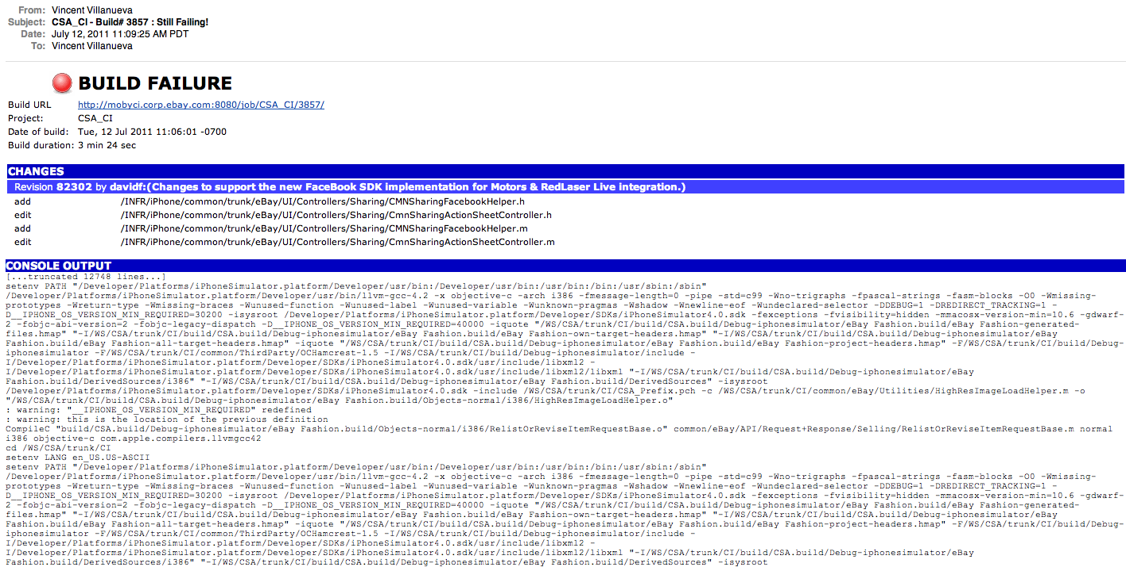
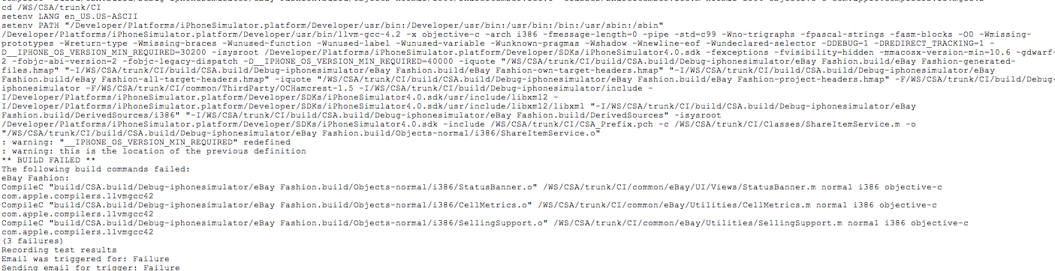
Build/Monitoring Tools
Email – Failure Notification

Slide 17
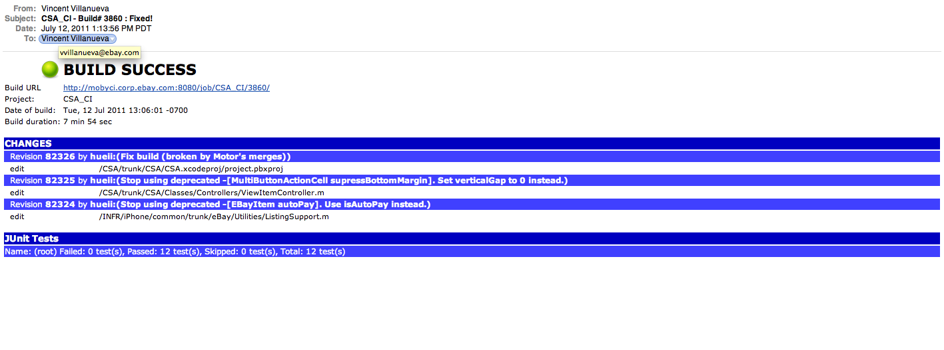
Build/Monitoring Tools
Email –Success Notification

Slide 18
Mobile Automation
DeviceAnywhere
Sep 21, 2011

Slide 19
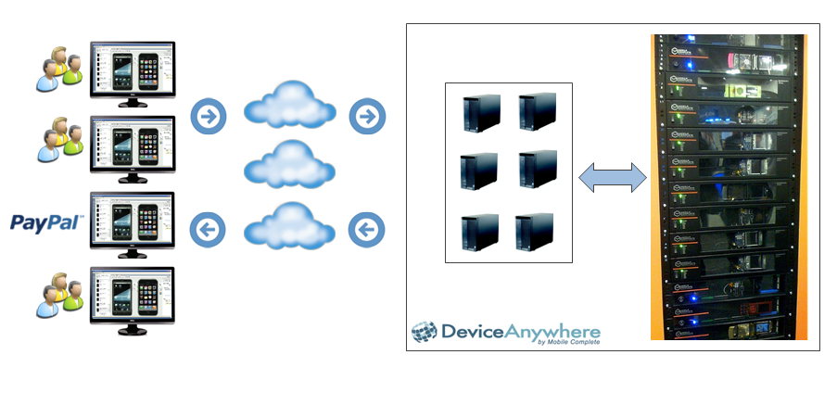
What is Device Anywhere?
Notes:
Comments (Ryan)
This slide is a bit odd – you are introducing DA but also giving a snapshot of what it was…….might want to add a intro to DA slide before this and give a 1 min overview and then have this slide and label it like ‘2010
- Takeaways should be 1) tool is shared across the world and while this works for quick manual testing – its not a easy solve for automation for variety of reasons. 2) Speed is also an issue on cloud device 3) Scripting? – personally not the biggest issue IMO

Slide 20
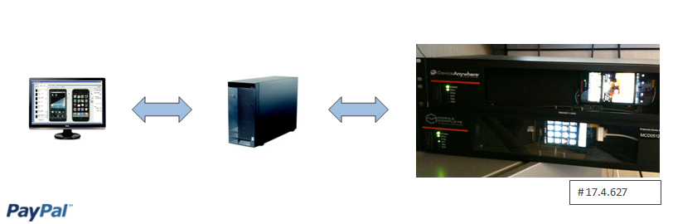
Device Anywhere: H2 2010
Notes:
Comments (Ryan)
Takeaways – 1) sole user environment gives greater flexibility and control (no reservation needed) 2) faster 3) expanded options – including scripting
Also – the solution evolved due to feedback we provided them for their client automation which resulted in changes on their side that allowed us to extend items

Slide 21
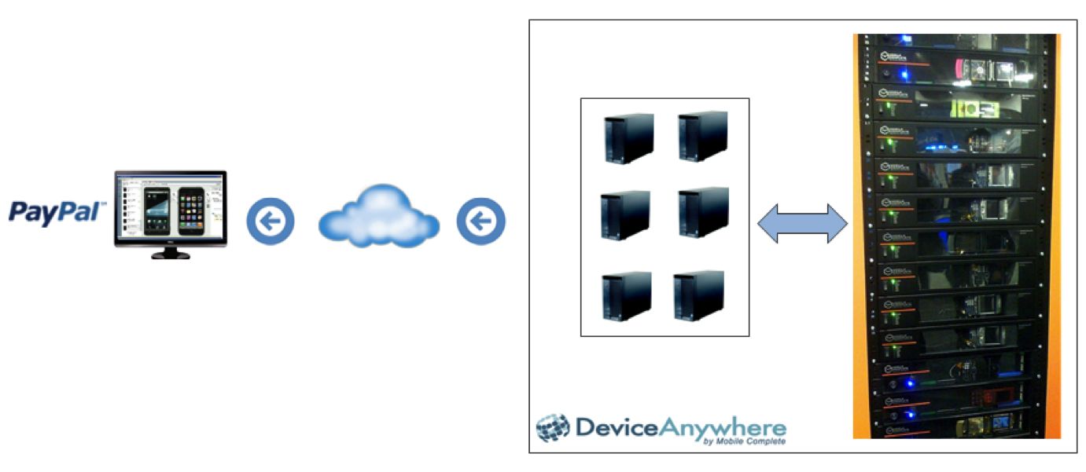
Device Anywhere: H2 2011
Dedicated Environment for PayPal

Slide 22
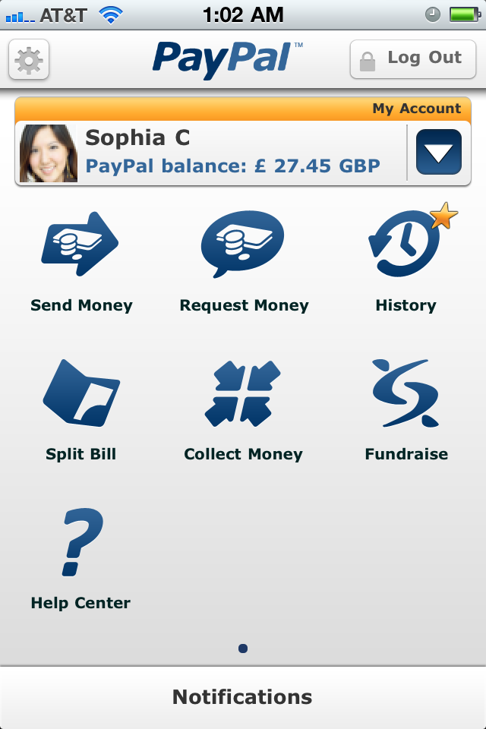
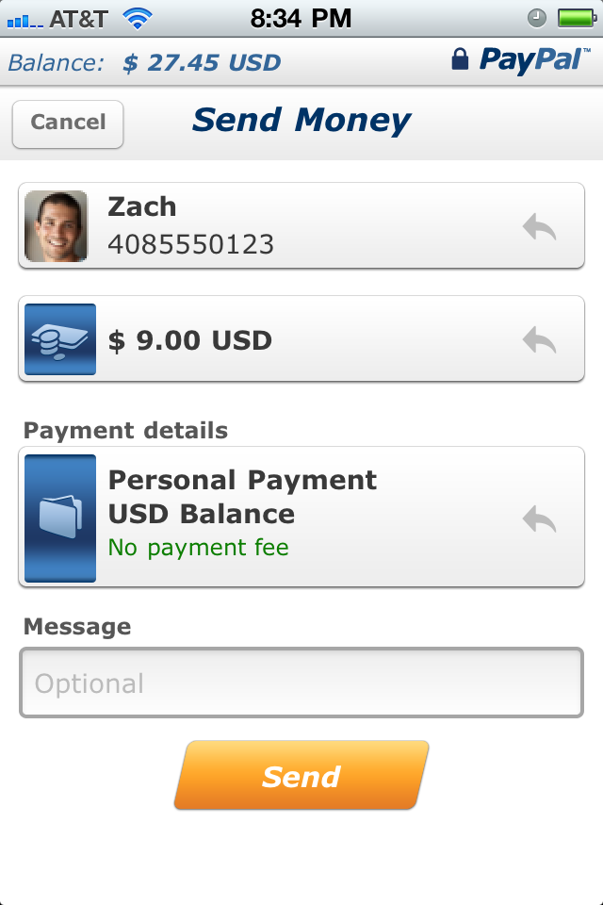
Why Device Anywhere?
Challenge:
Executing functional device testing manually is resource and time intensive
Goal:
Identify and automate a set of test cases that established a quality baseline which can be run on demand to provide a clear view on build quality
Notes:
Frequent broken builds

Slide 23
Device anywhere: concepts
A specific action performed on the device
Button Clicks
Keyboard Entry
Action
Test Case
Action
State
Image/Text validation done on the device
State
Notes:
Comments
1) Should list 2 examples under state validations to be consistent with Action

Slide 24
Device anywhere: Concepts
Functional flow
A
A
A
S
S
S
UI flow
A
A
A
S
S
S

Slide 25
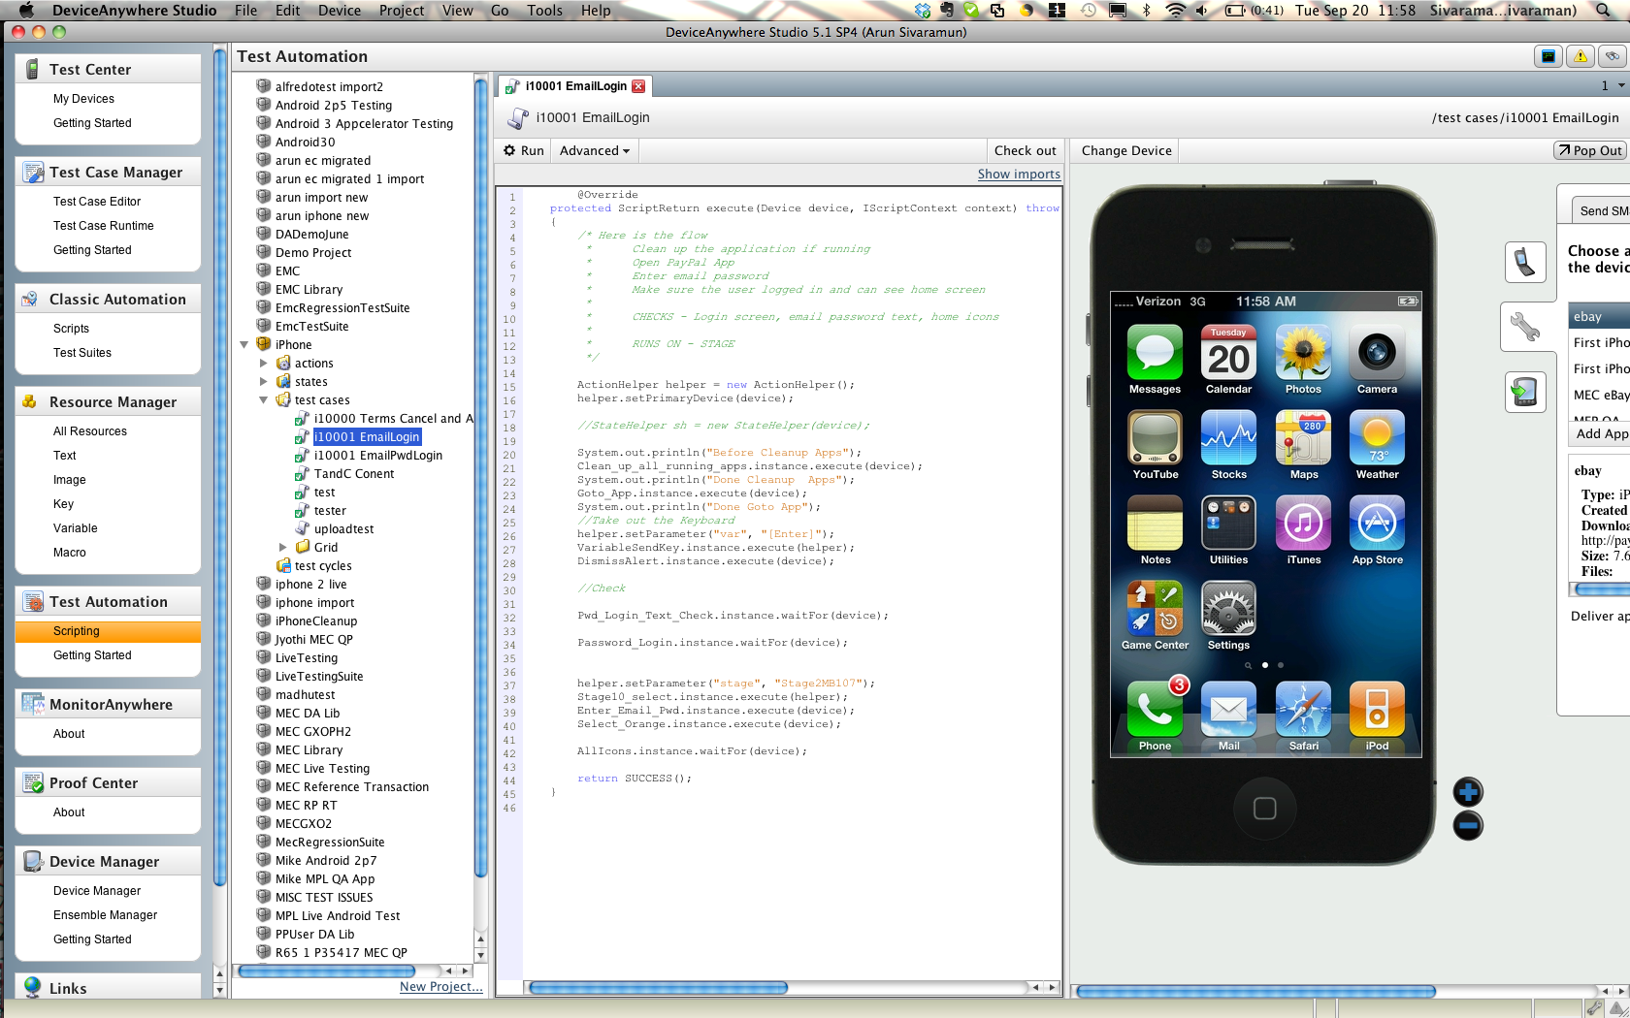
Device anywhere: Studio Workspace
Notes:
Why do we need to update the screenshot?

Slide 26
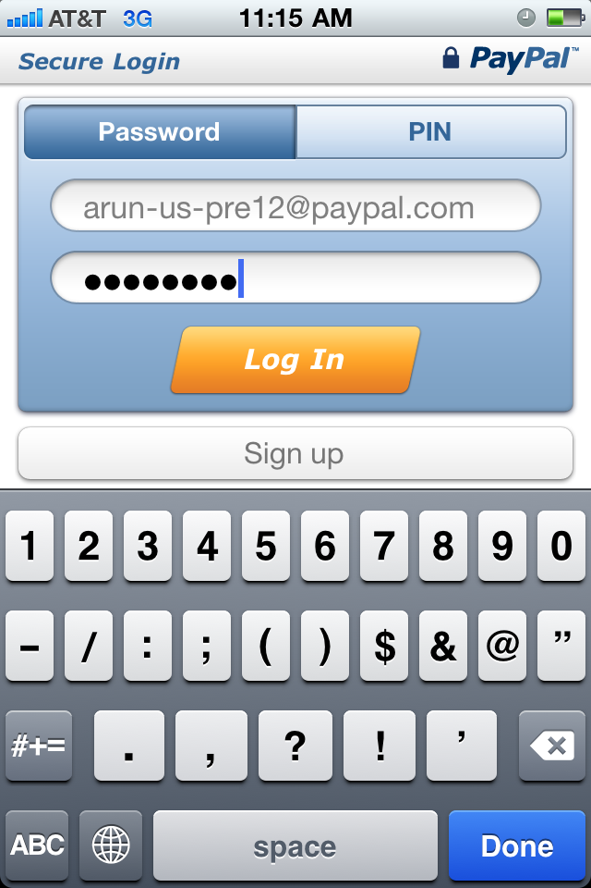
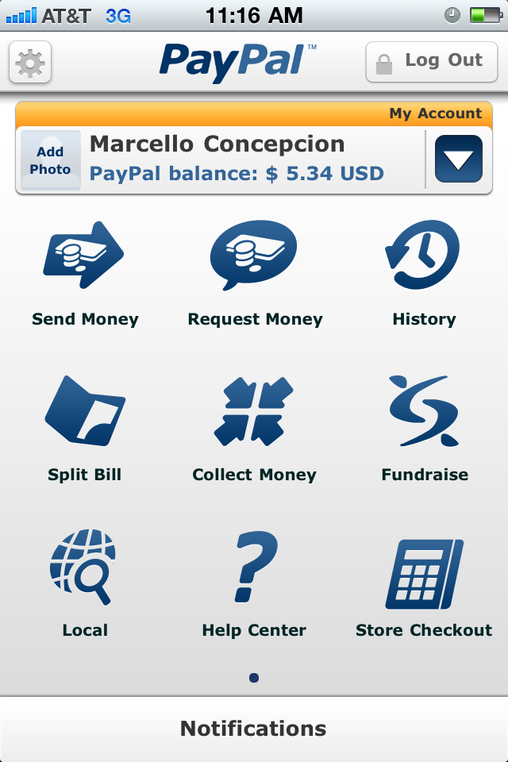
Additional Benefits - Internationalization
Notes:
Language independent state verification (like icons that are common between languages)
- Same test case can be run in multiple language settings – generates screen shot and video

Slide 27
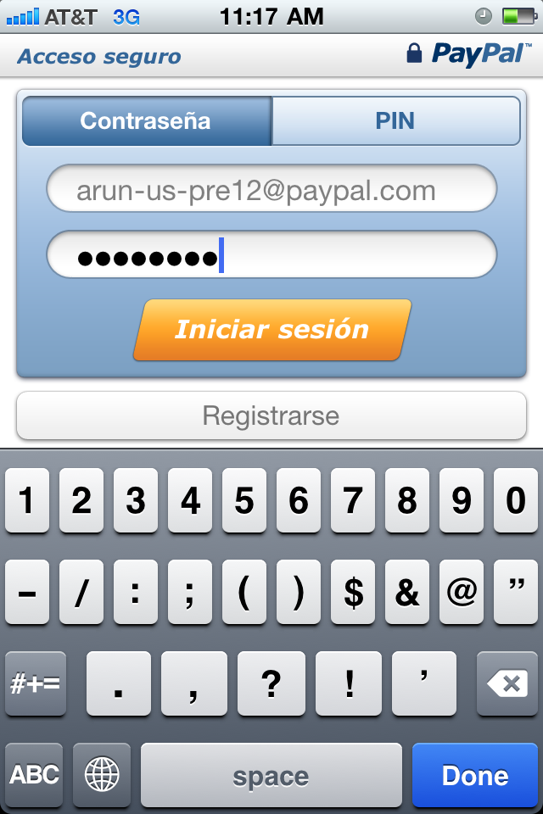
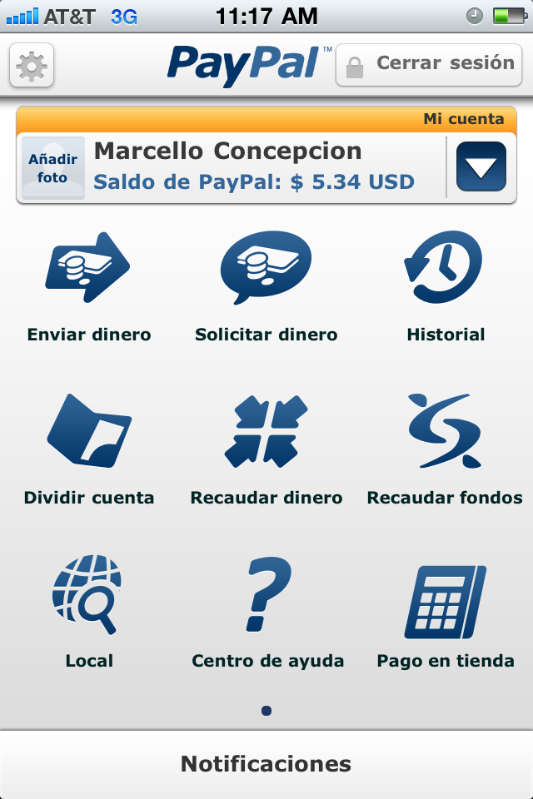
Additional Benefits - Internationalization

Slide 28
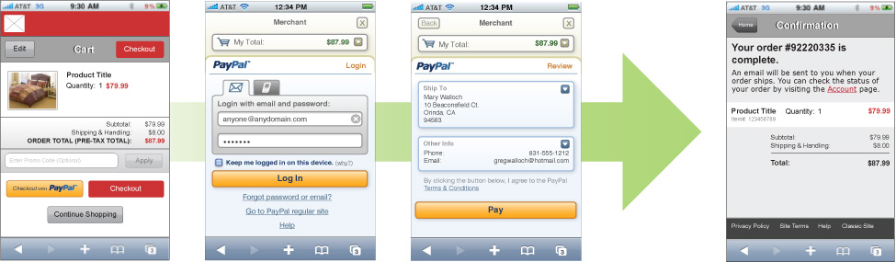
Additional Benefits – The MEC Use CAse
Set Express Checkout API
Do Express Checkout API
Get Express Checkout Details API
Notes:
----- Meeting Notes (3/18/11 14:52) -----
Can not be done with out of box DA

Slide 29
Mobile Automation: Java
Backend infrastructure with Java
Native Java API calls for Action and States
Integrate with already existing MegaJars for JAWS
JAWS brings in a whole bunch of PayPal test functionalities
eBay Mobile Checkout test case with DA has eBay and PayPal APIs working together
End to End testing made possible

Slide 30
PayPal iPhone P2P App Automation Demo

Slide 31
Mobile Automation : Continuous Integration
Hudson Server
DA Server
Email Alerts
1. Hudson builds Official QA Build
2.1 Script installs build and starts BAT
3. BAT execution is completed
4.1 Notify users by emails

Slide 32
Mobile Automation: RoadMaP
Integrate with continuous build system
End to end testing with in-app mobile web pages
Automate feature test cases
Simplified TC definition
Cross functional testing & training
Build out device pool based on consumer market
Possible integration with BlueFin (mega jars)
Notes:
Add way to read content file dynamically

Slide 33
Mobile Automation: Metrics
Manual BAT
~3 hours on a new build
Automation Investment
New tool kit creation = 7 days
Additional device = 2 days
Results
12 min runtime AND the ability to run entire suite on EVERY build with little to no manual intervention
Notes:
TODO
Need a number here

Slide 34
Q & A
Thank You!

